Slide 1


Slide 2
One night at a call center...
Probability density
Time between calls

Slide 3
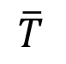
One night at a call center...
$$\overline{T}$$
Time between calls (T)
Observation No

Slide 4
One night at a call center...
Number of occurrence
Time between calls

Slide 5

Dot diagram for $\overline{T}$

Slide 6

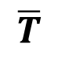
Histogram for for $\overline{T}$
Number of occurrence
$$\overline{T}$$

Slide 7
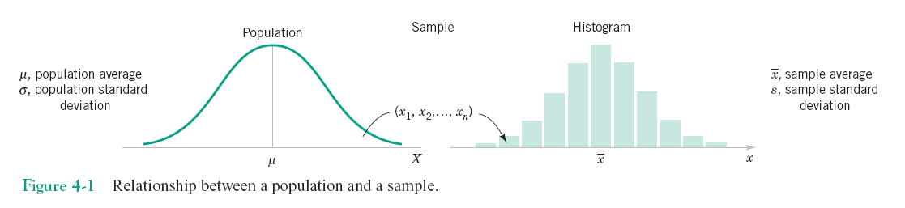
Statistical Inference
The field of statistical inference consists of those
methods used to make decisions or draw conclusions about a population.
These methods utilize the information contained in
a sample from the population in drawing
conclusions.

Slide 8
Statistical Inference
Estimation of parameters.
Point estimate
Interval estimate
Hypothesis testing.

Slide 9
Point estimation
A point estimate of a population parameter (e.g. population
mean) is a single numerical value of a statistic (e.g. sample
mean).
The statistic (e.g. sample mean) has its distribution.
There might be multiple options for the point estimate.
Example: Point estimate of population mean are:
Arithmetic mean
Median
One randomly selected value
Arithmetic mean of largest and smallest value
Which one to choose? Quality of an estimator.

Slide 10
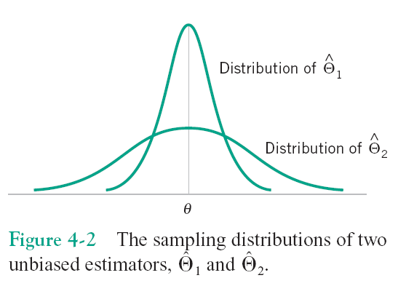
Unbiased estimators

Slide 11
One night at a call center...
$$\overline{T}$$
Time between calls (T)
Observation No

Slide 12
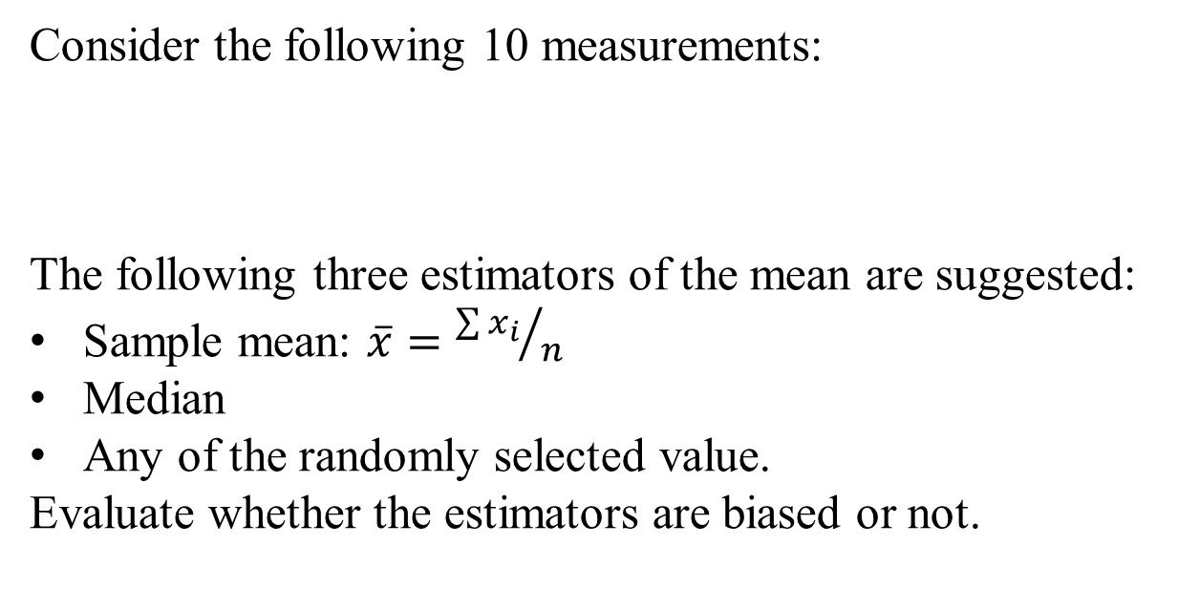
Merit of an estimator: Example-1
Consider the following 10 measurements:
The following three estimators of the mean are suggested:
Sample mean: $\overline{x}={\sum{x_{i}}}/n$
Median
Any of the randomly selected value.
Evaluate whether the estimators are biased or not.

Slide 13
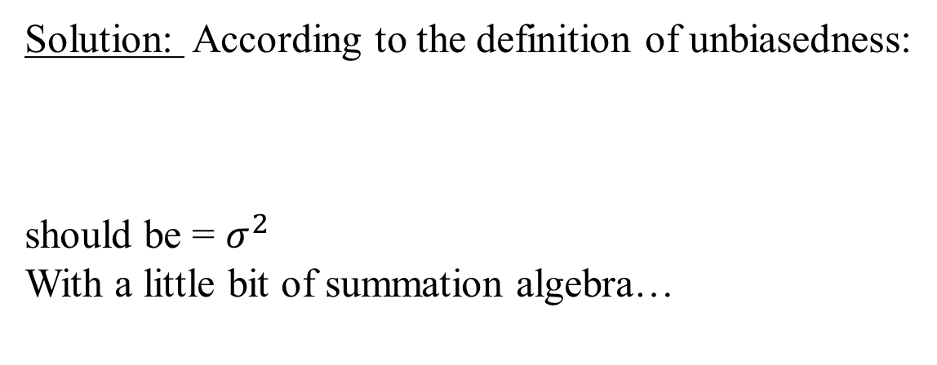
Unbiasedness
Example: Compare the following two estimates of population variance
and check which one is an unbiased estimator of population variance.
Solution: According to the definition of unbiasedness:
should be = $σ^{2}$
With a little bit of summation algebra…

Slide 14
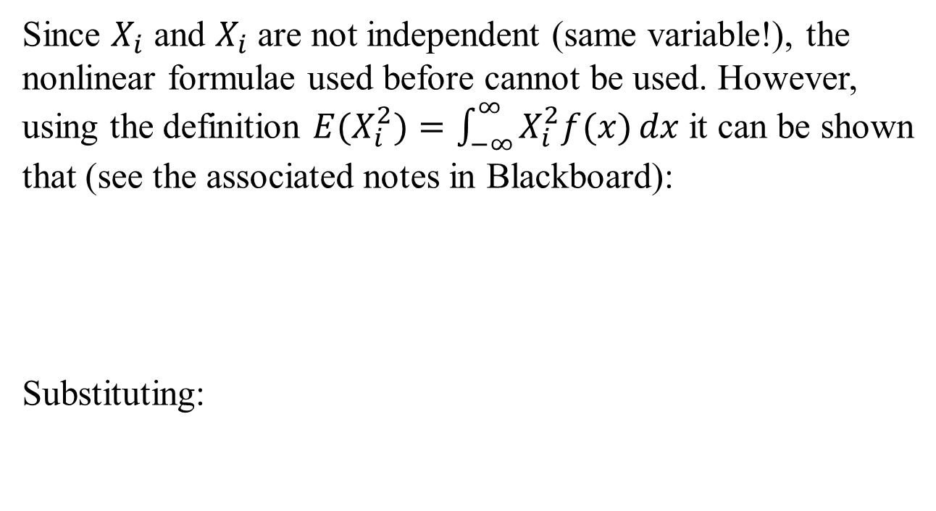
Unbiasedness
Since $X_{i}$ and $X_{i}$ are not independent (same variable!), the
nonlinear formulae used before cannot be used. However,
using the definition $E(X_{i}^{2})=\int_{−∞}^{∞}{X_{i}^{2}f(x)}dx$ it can be shown
that (see the associated notes in Blackboard):
Substituting:

Slide 15

Unbiasedness
Had we used
The bias of this estimator is then:
The bias decreases as $n$ increases.
The bias is zero for an unbiased estimator

Slide 16
Additional merit of an estimator
MVUE: Minimum Variance Unbiased Estimator

Slide 17
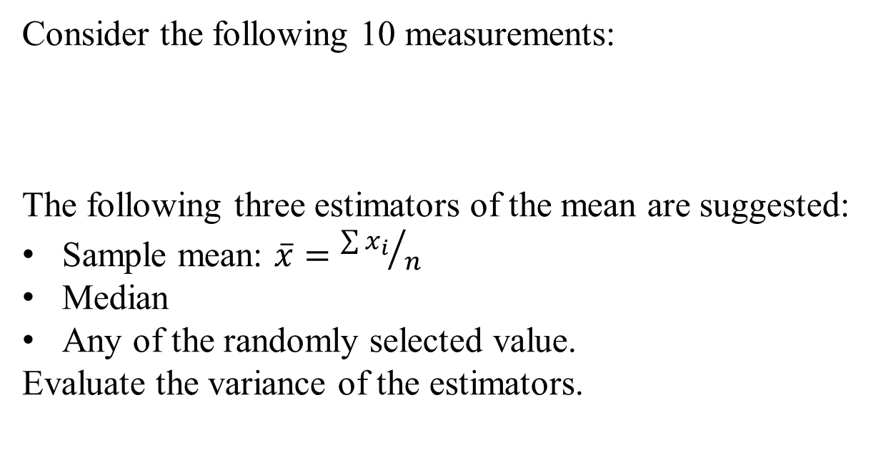
Merit of an estimator: Example-1 revisited
Consider the following 10 measurements:
The following three estimators of the mean are suggested:
Sample mean: $\overline{x}={\sum{x_{i}}}/n$
Median
Any of the randomly selected value.
Evaluate the variance of the estimators.

Slide 18
Additional merit of an estimator

Slide 19
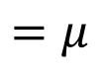
Mean square error
$$=μ$$

Slide 20
Mean square error
Probability Density
$$=μ$$

Slide 21
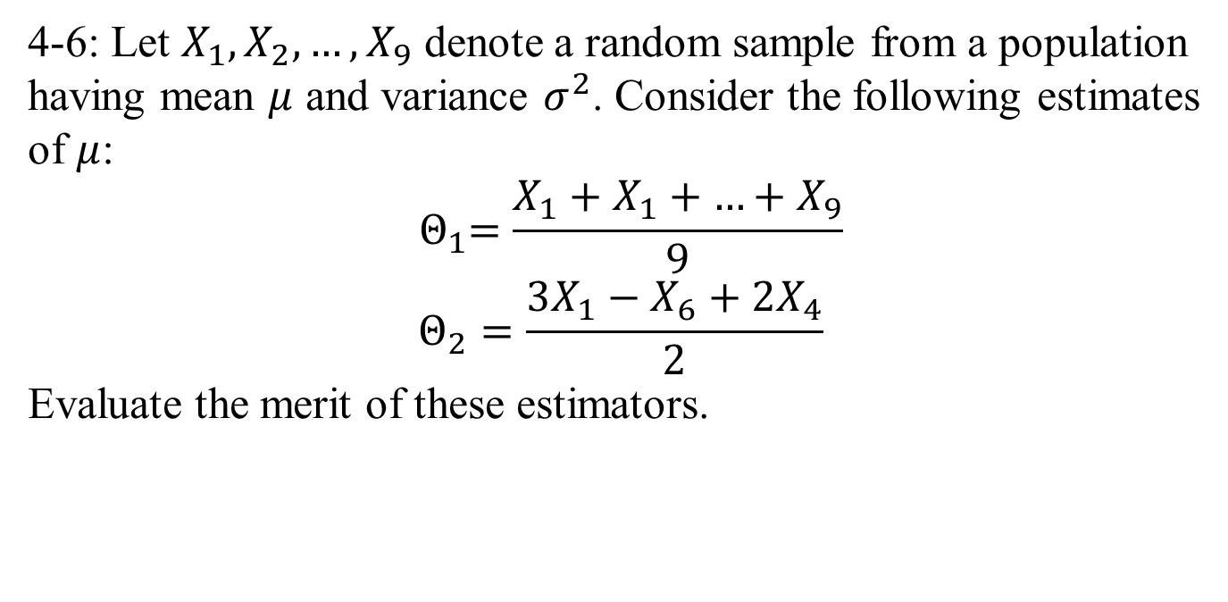
Merit of an estimator: Example-2
4-6: Let $X_{1},X_{2},{…, X}_{9}$ denote a random sample from a population
having mean $μ$ and variance $σ^{2}$. Consider the following estimates
of $μ$:
$${ Θ}_{1}=\frac{X_{1}+X_{1}+{…+X}_{9}}{9}$$
$$Θ_{2}=\frac{{3X}_{1}−X_{6}+{2X}_{4}}{2}$$
Evaluate the merit of these estimators.

Slide 22
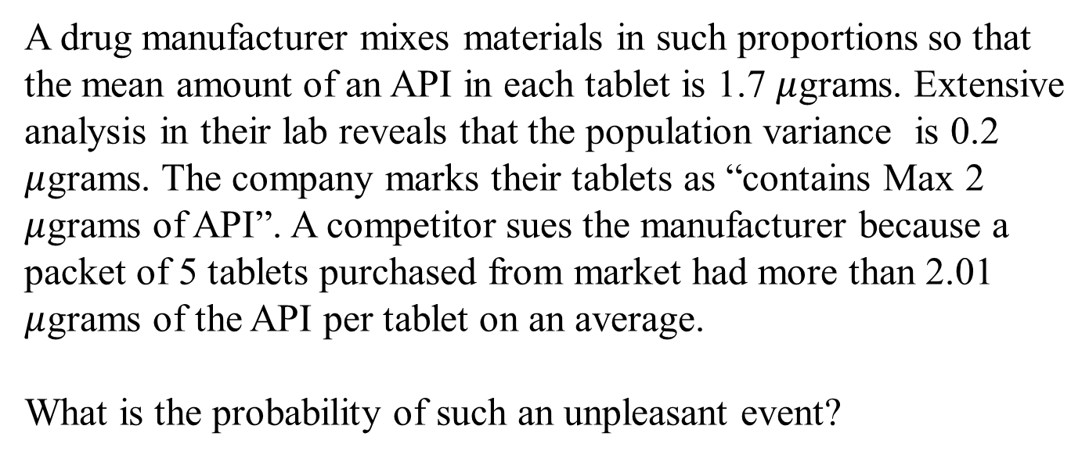
Additional Problems
A drug manufacturer mixes materials in such proportions so that
the mean amount of an API in each tablet is 1.7 $μ$grams. Extensive
analysis in their lab reveals that the population variance is 0.2
$μ$grams. The company marks their tablets as “contains Max 2
$μ$grams of API”. A competitor sues the manufacturer because a
packet of 5 tablets purchased from market had more than 2.01
$μ$grams of the API per tablet on an average.
What is the probability of such an unpleasant event?

Slide 23



Probability density functions of $X$ and $\overline{X}$
pdf of $\overline{X}$
pdf of $X$

Slide 24

Hypothesis Testing
We are interested in the burning rate of a solid propellant used to power aircrew escape systems.
Burning rate is a random variable that can be described by a probability distribution.
We are interested in the mean burning rate
Specifically, we are interested in deciding whether or not the mean burning rate is 50 centimeters per second.

Slide 25
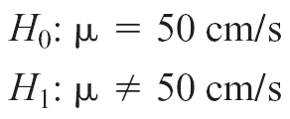
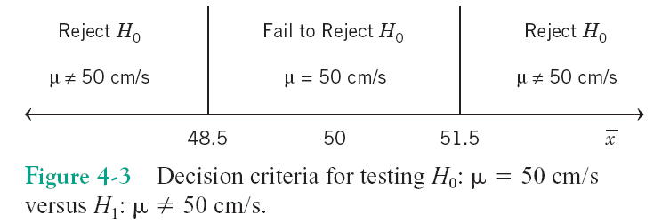
Statistical Hypotheses
Null hypothesis
Alternative hypothesis
Critical Region
Critical Region
Calculate the sample mean $\overline{X}$and test it against the criterion
We will assume that we know the population standard deviation $σ$

Slide 26
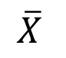
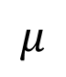
Statistical Hypotheses
Remember: $\overline{X}$is an estimate of $μ$. Hence, ordinarily $μ≠$ $\overline{X}$
$$\overline{X}$$
$$μ$$
No error ☺

Slide 27
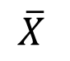
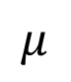
Statistical Hypotheses
$$\overline{X}$$
$$μ$$
No error ☺

Slide 28
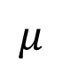

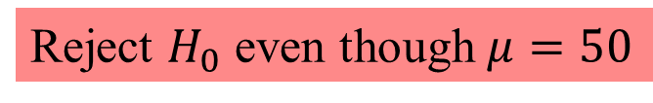
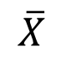
Statistical Hypotheses
Remember: $\overline{X}$is a random variable!
$$\overline{X}$$
$$μ$$
Reject $H_{0}$ even though $μ=50$

Slide 29
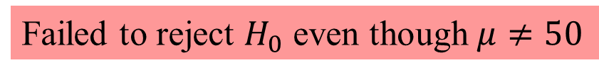
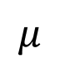
Statistical Hypotheses
Remember: $\overline{X}$is a random variable!
$$\overline{X}$$
$$μ$$
Failed to reject $H_{0}$ even though $μ≠50$

Slide 30
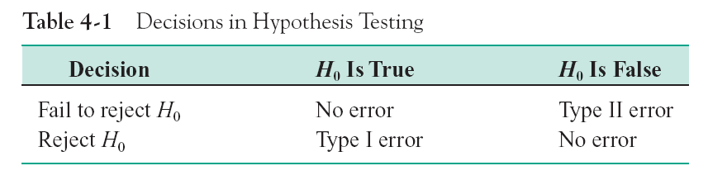
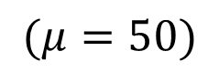
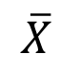
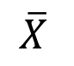
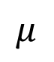
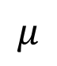
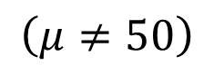
Type-I and Type II errors
$$(μ=50)$$
$$\left(μ≠50\right)$$
$$\overline{X}$$
$$\overline{X}$$
$$μ$$
$$μ$$

Slide 31

From Google Images

Slide 32
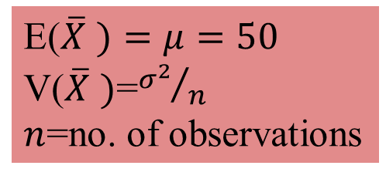

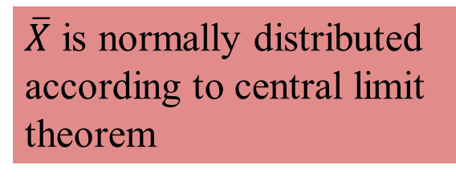
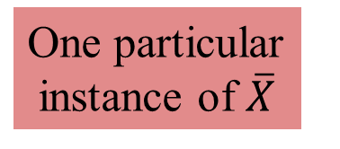
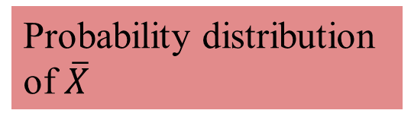
Type-I error
1
Relevant only when
$$μ=50$$
2
3
$\overline{X}$ is normally distributed
according to central limit
theorem
E($\overline{X}$ $)=μ=50$
V($\overline{X}$ $)$=${σ^{2}}/n$
$n$=no. of observations
Probability distribution
of $\overline{X}$
4
One particular
instance of $\overline{X}$
$$\overline{X}$$
$$μ$$

Slide 33
1
Type-I error
Relevant only when
$$μ=50$$
2
3
$\overline{X}$ is normally distributed
according to central limit
theorem
E($\overline{X}$ $)=μ=50$
V($\overline{X}$ $)$=${σ^{2}}/n$
$n$=no. of observations
Probability distribution
of $\overline{X}$
4
One particular
instance of $\overline{X}$
$$\overline{X}$$
$$μ$$

Slide 34
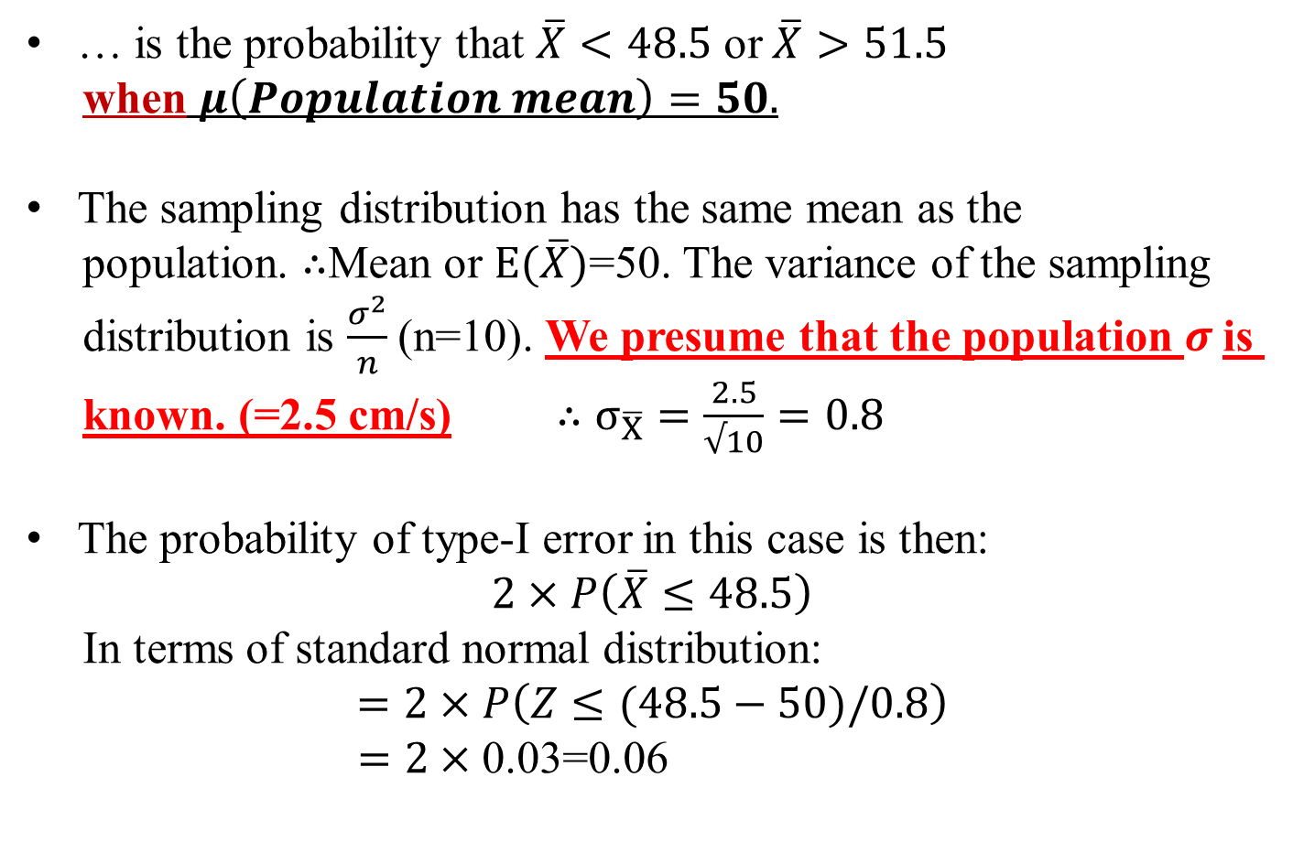
Probability of Type-I error…
… is the probability that $\overline{X}<48.5$ or $\overline{X}>51.5$
when $μ\left(Population mean\right)=50.$
The sampling distribution has the same mean as the
population. $∴$Mean or $E(\overline{X})$=50. The variance of the sampling
distribution is $\frac{σ^{2}}{n}$(n=10). We presume that the population $σ$is
known. (=2.5 cm/s) $∴σ_{\overline{X}}=\frac{2.5}{√10}=0.8$
The probability of type-I error in this case is then:
$$2×P\left(\overline{X}≤48.5\right)$$
In terms of standard normal distribution:
$$=2×P\left(Z≤(48.5−50)/0.8\right)$$
$=2×$0.03=0.06

Slide 35
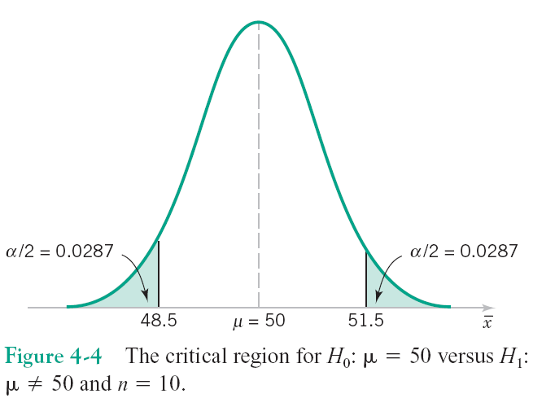
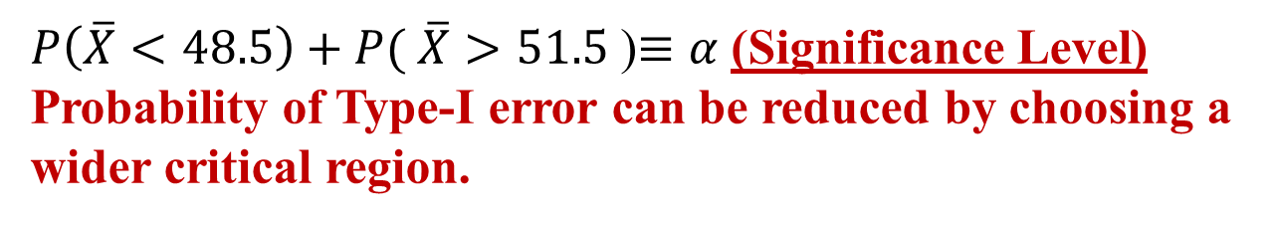
Probability of Type-I error…
$P\left(\overline{X}<48.5\right)+P( \overline{X}>51.5$ )$≡α$(Significance Level)
Probability of Type-I error can be reduced by choosing a
wider critical region.
Problem: Choose the critical region so that the significance level is
0.05. Keep the number of samples=10.

Slide 36
Probability of Type-I error
Problem: Choose the critical region so that the significance level is
0.05. Keep the number of samples=10.

Slide 37
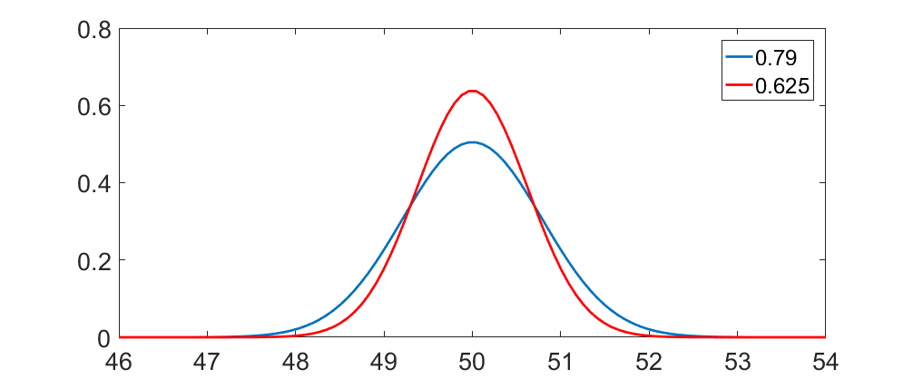
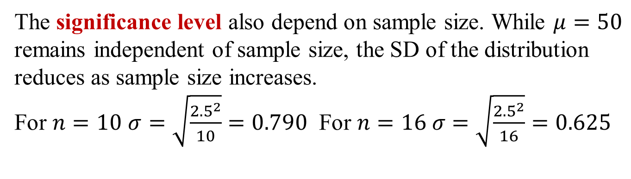
Significance level vs. sample size
The significance level also depend on sample size. While $μ=50$
remains independent of sample size, the SD of the distribution
reduces as sample size increases.
For $n=10$ $σ=\sqrt{\frac{{2.5}^{2}}{10}}=0.790$ For $n=16 σ=\sqrt{\frac{{2.5}^{2}}{16}}=0.625$

Slide 38
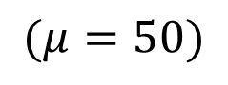
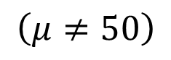
“Strong conclusion”
$$(μ=50)$$
$$\left(μ≠50\right)$$
Because we can control the sample size and width of the critical
region to arbitrarily reduce the probability of Type-I error,
the rejection of the null hypothesis is called “strong conclusion”

Slide 39
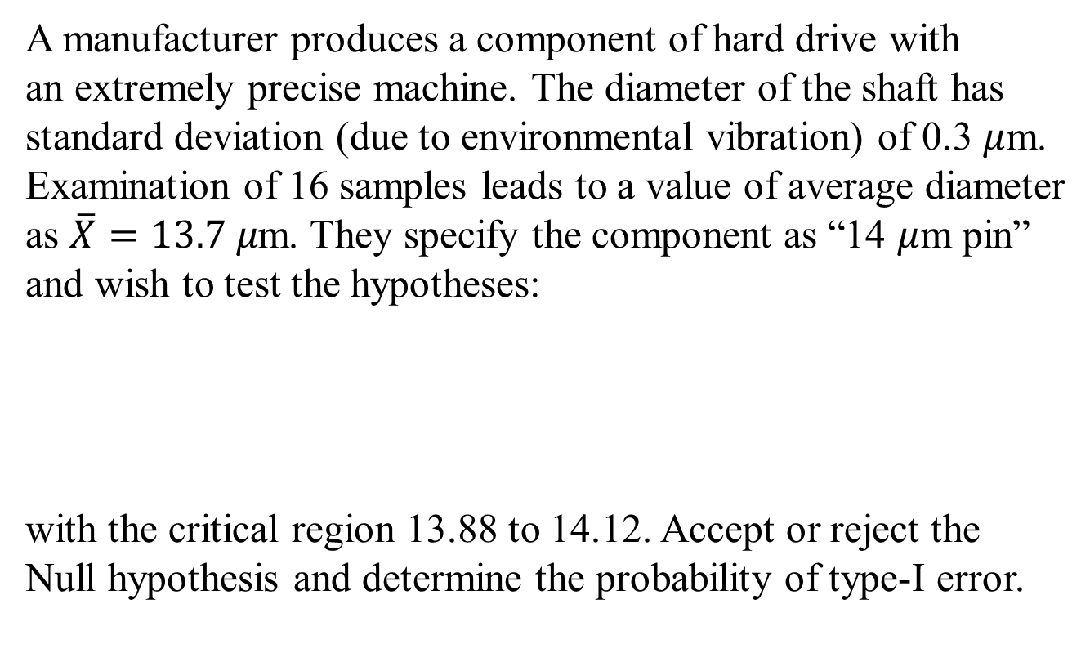
Hypothesis testing: Example
A manufacturer produces a component of hard drive with
an extremely precise machine. The diameter of the shaft has
standard deviation (due to environmental vibration) of 0.3 $μ$m.
Examination of 16 samples leads to a value of average diameter
as $\overline{X}=13.7 μ$m. They specify the component as “14 $μ$m pin”
and wish to test the hypotheses:
with the critical region 13.88 to 14.12. Accept or reject the
Null hypothesis and determine the probability of type-I error.

Slide 40
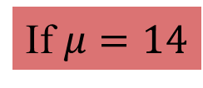
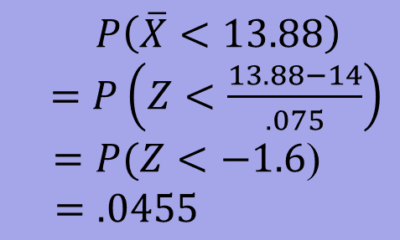
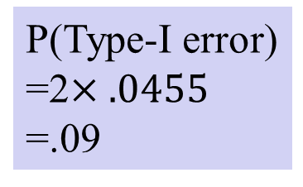
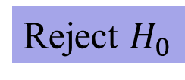
Hypothesis testing: Example
If $μ=14$
$\overline{X}$is normally distributed with $μ=14$ and $σ=\frac{0.3}{\sqrt{16}}=.075$.
$$P\left(\overline{X}<13.88\right)$$
$=P\left(Z<\frac{13.88−14}{.075}\right)$
$=P(Z<−1.6$)
$$=.0455$$
Reject $H_{0}$
P(Type-I error)
=2$×.0455$
=.09

Slide 41
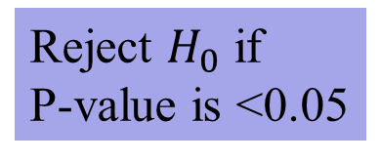
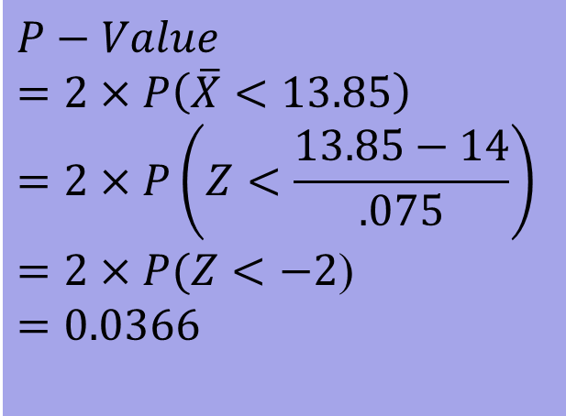
P-value approach
$$P−Value$$
$$=2×P\left(\overline{X}<13.85\right)$$
$$=2×P\left(Z<\frac{13.85−14}{.075}\right)$$
$=2×P(Z<−2$)
$=0.0366$
Reject $H_{0}$ if
P-value is <0.05

Slide 42
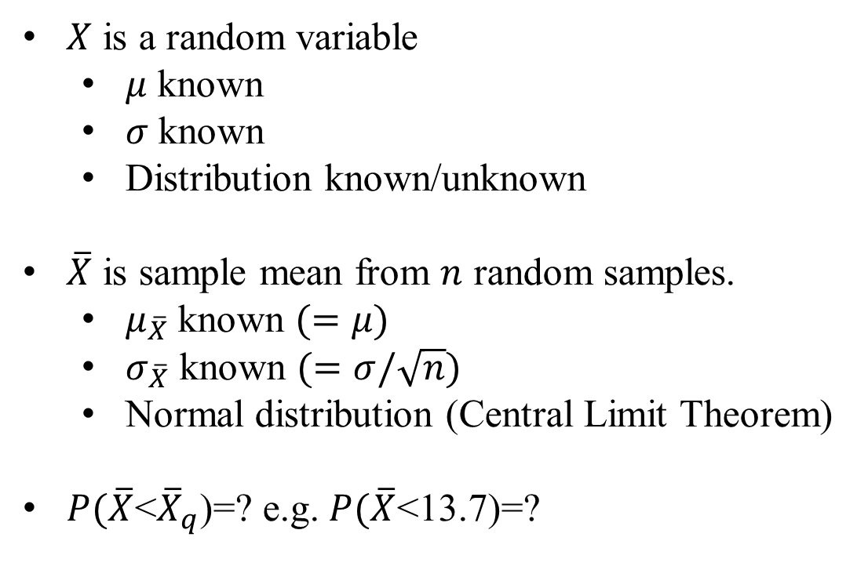
Chapter-3 vs Chapter-4: Chapter-3
$X$ is a random variable
$μ$ known
$σ$ known
Distribution known/unknown
$\overline{X}$ is sample mean from $n$ random samples.
$μ_{\overline{X}}$ known $(=μ)$
$σ_{\overline{X}}$ known $(=σ/\sqrt{n})$
Normal distribution (Central Limit Theorem)
$P(\overline{X}$<${\overline{X}}_{q}$)=? e.g. $P(\overline{X}$<13.7)=?

Slide 43
Chapter-3

Slide 44
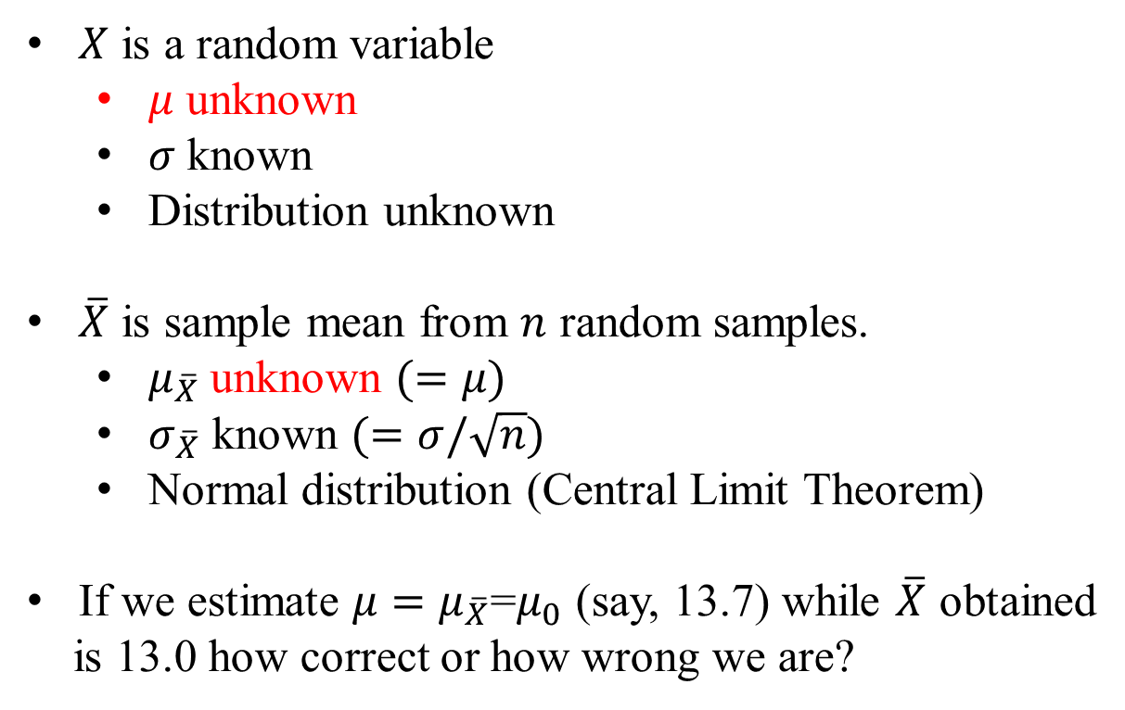
Chapter-3 vs Chapter-4: Chapter-4
$X$ is a random variable
$μ$ unknown
$σ$ known
Distribution unknown
$\overline{X}$ is sample mean from $n$ random samples.
$μ_{\overline{X}}$ unknown $(=μ)$
$σ_{\overline{X}}$ known $(=σ/\sqrt{n})$
Normal distribution (Central Limit Theorem)
If we estimate $μ=μ_{\overline{X}}$=$μ_{0}$ (say, 13.7) while $\overline{X}$ obtained
is 13.0 how correct or how wrong we are?

Slide 45
Chapter-4

Slide 46
Type-I and Type II errors
$$(μ=50)$$
$$\left(μ≠50\right)$$
$$\overline{X}$$
$$\overline{X}$$
$$μ$$
$$μ$$

Slide 47
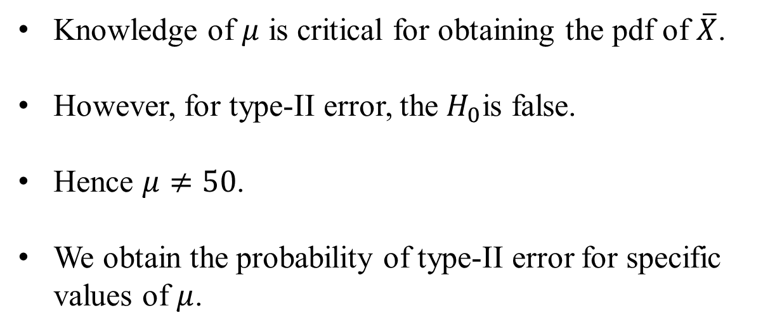

Probability of Type-II error $(β)$
Knowledge of $μ$ is critical for obtaining the pdf of $\overline{X}$.
However, for type-II error, the $H_{0}$is false.
Hence $μ≠50$.
We obtain the probability of type-II error for specific values of $μ$.

Slide 48
Type-I error

Slide 49
Type-I error

Slide 50


Probability of Type-II error $(β)$
$$(μ=50)$$
$$\left(μ≠50\right)$$
$$\overline{X}$$
$$μ$$

Slide 51





Probability of Type-II error $(β)$
E($\overline{X}$ $)=μ=52$
V($\overline{X}$ $)$=${σ^{2}}/n=\frac{{2.5}^{2}}{10}$
$n$=No. of observations
$$μ_{0}$$
$$\overline{X}$$
$$μ$$
$$β_{52}≡P(48.5≤\overline{X}≤51.5)$$

Slide 52


Probability of Type-II error $(β)$
$β_{52}≡P\left(48.5≤\overline{X}≤51.5\right)$ in $N\left(52,0.79\right)$
$$=P\left(\frac{48.5−52}{0.79}≤Z≤\frac{51.5−52}{0.79}\right)$$
$=P\left(−4.43≤Z≤−0.633\right)$
$=Φ\left(−0.633\right)−Φ\left(−4.43\right)$
$≈Φ\left(−0.633\right)=0.233$
$$μ_{\overline{X}}=52$$
$$σ_{\overline{X}}={2.5}/{\sqrt{10}}=0.79$$
$n$=No. of observations=10
$$μ_{0}$$
$$\overline{X}$$
$$μ$$

Slide 53


“Weak conclusion”
$$(μ=50)$$
$$\left(μ≠50\right)$$
Because the probability of Type-II error is dependent on the true
value of the mean which is unknown, the acceptance of null
hypothesis is called “weak conclusion”

Slide 54




$β$ as a function of $μ$ and $n$
Power $≡$ $1−β$
Power to distinguish between $μ$ and $μ_{1}$

Slide 55


“Power” to distinguish and sample size
$$μ_{0}$$
$$μ$$

Slide 56
$$μ_{0}$$
$$μ$$

Slide 57
$$μ_{0}$$
$$μ$$

Slide 58
$$μ_{0}$$
$$μ$$

Slide 59

We want to calculate $n$ from given $β$

Slide 61




Calculation of sample size (n)
Define: $Z=\frac{\overline{X}−μ_{0}}{σ/{\sqrt{n}}}$.
$$\frac{μ−μ_{0}}{σ/{\sqrt{n}}}=\frac{δ}{σ/{\sqrt{n}}}=\frac{δ\sqrt{n}}{σ}$$
$$\frac{δ\sqrt{n}}{σ}$$
$$0$$

Slide 62



Calculation of sample size (n)
$β=P\left({−z}_{α/2}<Y<z_{α/2}\right)$ in $N\left(\frac{δ\sqrt{n}}{σ},1\right)$
$=P\left(\frac{{−z}_{α/2}−\frac{δ\sqrt{n}}{σ}}{1}<Z<\frac{z_{α/2}−\frac{δ\sqrt{n}}{σ}}{1}\right)$ in Std. Normal
$$=Φ{(z}_{α/2}−\frac{δ\sqrt{n}}{σ})−Φ{(−z}_{α/2}−\frac{δ\sqrt{n}}{σ})$$
$≈Φ{(z}_{α/2}−\frac{δ\sqrt{n}}{σ})$

Slide 63
Calculation of sample size: Example
Problem: Suppose the analyst wishes to design a test so that if
the mean burning rate differs from 50 cm/s by as much as 1 cm/s,
the test will detect this with 90% probability. Use significance
level of 0.05.

Slide 64
One sided test
Null hypothesis
Alternative hypothesis
Critical Region

Slide 65


One sided test: Type-I error
Null hypothesis
Alternative hypothesis
$$\overline{X}$$
$$μ$$

Slide 66
One sided test: Type-I error
$$\overline{X}$$
$$μ$$

Slide 67
One sided test: Type-I error
Null hypothesis
Alternative hypothesis
$$\overline{X}$$
$$μ$$

Slide 68

One sided test: Type-II error
Null hypothesis
Alternative hypothesis
$$\overline{X}$$
$$μ$$

Slide 69

Hypothesis testing: Example
Exercise: 4-15: A textile fiber manufacturer is investigating the
tensile strength of a new drapery yarn, which has a standard deviation
of 0.3 kg. The company wishes to test the hypothesis:
using a random sample of 5 specimens.
What is the P-value if $\overline{x}=13.7$ kg?
Find $β$ when the true mean elongation force is 13.5 kg.
Assume $α=0.05$.
What is the power of the test for part (b)?

Slide 70
Hypothesis testing: Example
If $μ=14$
$\overline{X}$is normally distributed with $μ=14$ and $σ=\frac{0.3}{\sqrt{5}}=.134$

Slide 71

Hypothesis testing: Example
If $μ=14$
$\overline{X}$is normally distributed with $μ=14$ and $σ=\frac{0.3}{\sqrt{5}}=.134$
$$P−value=P\left(\overline{X}<13.7\right)$$
$=P\left(z<\frac{13.7−14}{.134}\right)$
$=P(z<−2.24$)
$$=.0125$$

Slide 72


Hypothesis testing: Example
(b) Find $β$ when the true mean elongation force is 13.5 kg.
Assume $α=0.05$.
Plan: We need to know
the lower boundary of the
critical region. This has to
be obtained from $α=0.05$.
Once the boundary is known,
the probability $(β)$can be
obtained from the normal
distribution with $μ=13.5$
and $σ=0.134$.

Slide 73


Hypothesis testing: Example
(b) Find $β$ when the true mean elongation force is 13.5 kg.
Assume $α=0.05$.
Plan: We need to know
the lower boundary of the
critical region. This has to
be obtained from $α=0.05$.
Once the boundary is known,
the probability $(β)$can be
obtained from the normal
distribution with $μ=13.5$
and $σ=0.134$.

Slide 74

Procedure for hypothesis testing on mean, population variance known.

Slide 75
Apply…

Slide 76


Historical ecology and the conservation of large, hermaphroditic fishes in Pacific Coast kelp forest ecosystems
Science Advances 01 Feb 2017: Vol. 3, no. 2, e1601759

Slide 77
Interval estimate of the Mean
Instead of a point estimate of the mean, we want the values of L and U as ‘interval estimate’ of mean:

Slide 78
Confidence Interval on the Mean
Instead of a point estimate of the mean, we want the values of L and U as ‘interval estimate’ of mean:
L and U are functions of $\overline{X}$ and hence are random variables.

Slide 79



Confidence Interval: Yardstick
Population $σ$ known
$$σ_{\overline{X}}=σ/{√n}$$
Sampling distribution
of $\overline{X}$
2.5%
2.5%

Slide 80


Confidence Interval
Black curve: true
distribution of $\overline{X}$
one occurrence of $\overline{X}$

Slide 81

Confidence Interval
Black curve: true
distribution of $\overline{X}$
another occurrence of $\overline{X}$

Slide 82
Confidence Interval
Black curve: true
distribution of $\overline{X}$
another occurrence of $\overline{X}$

Slide 83
Confidence Interval
Black curve: true
distribution of $\overline{X}$
another occurrence of $\overline{X}$

Slide 84
Confidence Interval
Black curve: true
distribution of $\overline{X}$
another occurrence of $\overline{X}$

Slide 85

Confidence interval: interpretation

Slide 86


Confidence interval: calculation
Normal distribution
Of $\overline{X}$
$$\overline{X}$$

Slide 87
Confidence interval: calculations

Slide 88

Confidence Interval on the Mean

Slide 89

Confidence Interval: Example
4-31: Consider the following data
for the hypothesis testing problem:
$$\overline{X}$$ | $$σ$$ | $$N$$ | $SE$ Mean | 95% CI | Z | P
31.2 | 1.2 | 16 | ? | ? | ? | ?

Slide 90

Confidence Interval: Example
$$\overline{X}$$ | $$σ$$ | $$N$$ | $SE$ Mean | 99% CI | Z | P
31.2 | 1.2 | 16 | $$=\frac{1.2}{\sqrt{16}}=0.3$$ | $$\left(31.2−2.58×0.3,31.2−2.58×.3\right)$$ $=($30.426,31.974) | $$\frac{31.2−30}{0.3}=4$$ | 0

Slide 91
Historical ecology and the conservation of large, hermaphroditic fishes in Pacific Coast kelp forest ecosystems
Science Advances 01 Feb 2017: Vol. 3, no. 2, e1601759

Slide 92
What if the population variance is unknown?

Slide 93

What if the population variance is unknown?
The “sampling distribution” of the “statistic” $Z=\frac{\overline{X}−μ}{σ/{\sqrt{n}}}$ plays the vital role in determining the probability.
If $σ$ is unknown, $Z$ cannot be calculated even for a
hypothesized value of $μ$.
An approximation of Z is T$=\frac{\overline{X}−μ}{S/{\sqrt{n}}}$
As $n→∞$, $s→$ $σ$ and T$→Z$.

Slide 94


Probability density function for T
$$k=n−1$$
The density function changes with n !!!

Slide 95



Probability density function for T
$$\left[α\right] Equiv to 1−Φ\left(Z\right)$$
$$\left[t\right] Equiv to Z$$
$$\left[ν\right]=n−1$$

Slide 96

Population variance is unknown:
Sample variance to replace population variance
The new random variable is NOT NORMALLY DISTRIBUTED
The overall structure of hypothesis testing remains the same.
T-distribution is to be used instead of standard normal distribution

Slide 97

Hypothesis Testing on the Mean
Obtain $\overline{X}$ and $s$using n samples
Obtain the test statistics $T={(\overline{X}−μ_{0})}/{(S/{\sqrt{n}})}$
Choose the correct distribution
using $n−1$ as degree of freedom
P-value

Slide 98

Using T-distribution: example
Elasticity of a metal ball is being tested. Test of 15 samples show the following coefficient of restitution:
The sample mean and sample standard deviation are: $\overline{X}=0.83725, s=0.02456$.
It is of interest to determine if there is evidence (with $α=0.05)$to support the claim: “mean mechanical strength exceeds 0.82”.
0.8411 | 0.8191 | 0.8182 | 0.8125 | 0.8750
0.8580 | 0.8532 | 0.8483 | 0.8276 | 0.7983
0.8042 | 0.8730 | 0.8282 | 0.8359 | 0.8660

Slide 99
Using T-distribution: example
Formulate the test:

Slide 100
Using T-distribution: example
Formulate the test:
Compute the test statistics:

Slide 101

Using T-distribution: example
$$t=2.72$$
Obtain the P-value:
Reject H₀

Slide 102
Student’s (William Sealy Gosset) T-distribution
“Central” T-distribution

Slide 103


Slide 104
Using T-distribution: type-2 error

Slide 105
Using T-distribution: type-2 error

Slide 106




Using T-distribution: type-2 error
Two sided, $α=0.05$
One sided, $α=0.05$
Two sided, $α=0.01$
One sided, $α=0.01$

Slide 107

Using T-distribution: type-2 error
=$β$

Slide 108
Using T-distribution: type-2 error

Slide 109
Using T-distribution: type-2 error
=$β$

Slide 110
Using T-distribution: type-2 error

Slide 111
Using T-distribution: example
If the mean mechanical strength is 0.84 instead of 0.82, what is the probability of type-II error for a significance level of 0.05?
One sided test. $d=\frac{0.02}{.02456}=0.81, n=15: β=0.1,$

Slide 112


Hypothesis Testing on the Variance of a
Normal Population
For mean: $z=\frac{\overline{X}−μ}{σ/√n}$ or T$=\frac{\overline{X}−μ}{s/√n}$

Slide 113


$Χ^{2}$distribution
Expected value: $k$
Variance: $2k$

Slide 114
$Χ^{2}$distribution

Slide 115
Hypothesis Testing on the Variance: Example
4-67: If the standard deviation of the hole diameter for
a rivet hole exceeds 0.02 mm, the beam should be rejected.
Random samples of 15 rivet holes shows a sample standard
deviation to be 0.016.
Is there a strong evidence to believe that the hole
diameter exceeds 0.02 mm?
(b) Will the conclusion change if the data were obtained
with a sample size of 3?

Slide 116


Hypothesis Testing on the Variance: Example
For $χ^{2}=8.96, 0.5≤α≤0.9$
Failed to reject $H_{0}$. There is no strong evidence that
the standard deviation exceeds 0.02.

Slide 117
Hypothesis Testing on the Variance: Example

Slide 118





Hypothesis Testing: Reviewing the main idea
$$Z=\frac{\overline{X}−μ_{0}}{σ}$$
$$Χ^{2}=\frac{(n−1)s^{2}}{σ_{0}^{2}}$$
T$=\frac{\overline{X}−μ_{0}}{S}$
If variance is${ σ}_{0}^{2}, s^{2}$ will be near $σ_{0}^{2}$
$Χ^{2}$ will be near $(n−1)$
If mean is $μ_{0}, \overline{X}$ will be near $μ_{0}$
Z,T will be near 0

Slide 119

How do we know if the population is normally
Distributed or not?
Probability$≡$ Relative frequency
Ordinate in cumulative of pdf
$=$ Probability
= Frequency in normalized cumulative histogram

Slide 120
Age of randomly selected 30 persons in University campus
24 20 25 24 21 19 19
21 26 24 24 24 23 24
22 23 20 18 23 25 24 21 22 22 25 27 21 22
26 25

Slide 121

Prepare a normalized cumulative histogram
Probability that age is $≤$ 21 years

Slide 122
Compare with a hypothesized distribution

Slide 123


Visual inspection
$$e^{−x^{3}}$$
$$e^{−x^{2}}$$

Slide 124
Change the y-axis to force it into linear
0.95
0.6
0.5

Slide 125
Change the y-axis to force it into linear
0.95
0.6
0.5

Slide 126
Change the y-axis to force it into linear
0.95
0.6
0.5

Slide 127
Data table for normal Probability Plot
Range | Mid point of range | Frequency | Normalized frequency | Cumulative normalized frequency
18-20 | 19 | 3 | 0.10 | 0.10
20-22 | 21 | 6 | 0.20 | 0.30
22-24 | 23 | 6 | 0.20 | 0.50
24-26 | 25 | 11 | 0.37 | 0.87
26-28 | 27 | 3 | 0.10 | 1.00
 |  | Total=29

Slide 128
Normal Probability Plot

Slide 129
Unsatisfactory fit into normal probability plot

Slide 130
Good fit into log normal probability plot

Slide 131
Very large data set

Slide 132
Very large data set

Slide 133
Very large data set

Slide 134
Very large data set

Slide 135
Very large data set

Slide 136

Cumulative frequency with less data
176, 183, 185, 190, 191, 192, 201, 205, 214, 220
Range | Mid point of range Value $(x)$ | Frequency | Normalized frequency | Cumulative normalized frequency $$Φ(x)$$
18-20 | 176 | 1 | 1/n | 1/n
20-22 | 183 | 1 | 1/n | 2/n
22-24 | 185 | 1 | 1/n | ⁞
24-26 | 190 | 1 | 1/n | j/n
26-28 | 191 | 1 | 1/n | ⁞
⁞ | ⁞ | ⁞ | ⁞ | ⁞
 |  | Total=n | 1.0

Slide 137
Cumulative frequency: discontinuous step function
3
2
1
0
176
183
185
190

Slide 138
Cumulative frequency: Correction
1
0.5
0
176

Slide 139

Cumulative frequency: Correction
176, 183, 185, 190, 191, 192, 201, 205, 214, 220
2
1.5=2-0.5
1
183
0.5=1-0.5
0
176
Cumulative frequency $=j−0.5$
Normalized cumulative frequency $=\frac{j−0.5}{n}$

Slide 140

X vs its Cumulative frequency (cumulative probability)
Normalized and
corrected cumulative
Frequency (Cumulative probability)
Cumulative
Frequency
$$x$$

Slide 141
Probability plot

Slide 142



Probability plot: using z table
$$Φ(z)$$
$$z=\frac{x−μ}{σ}$$
No need to know the values of $μ$ and $σ$.
No need for special graph paper

Slide 143
Probability plot: using z table
$$Φ(z)$$
$$z=\frac{x−μ}{σ}$$
No need to know the values of $μ$ and $σ$.
No need for special graph paper

Slide 144
Comparing the bell curve with histogram

Slide 145
Comparing the bell curve with histogram

Slide 146
Comparing the bell curve with histogram

Slide 147

Comparison of expected and observed frequency
Range | Observed frequency${(O}_{i})$ | Expected probability (If normal) Hypothesis! | Expected frequency $${(E}_{i})$$ | Difference (Random Variable)
18-20 | 3 | 0.09 | 2.7 | 0.3
20-22 | 6 | 0.25 | 7.5 | -1.5
22-24 | 6 | 0.33 | 9.9 | -3.9
24-26 | 11 | 0.22 | 6.6 | 4.4
26-28 | 3 | 0.08 | 2.4 | 0.6
 | Total=30

Slide 148



Hypothesis testing for goodness of fit
$O_{i}$ is the observed frequency in an interval (or discrete point)
$E_{i}$ is the expected frequency in that interval for the hypothesized
Probability density/mass function.
The degree of freedom is $k−p−1$

Slide 149
Number of parameters in a distribution

Slide 150
Rejection criterion
Reject $H_{0}$ if P-value is <0.05
We will not reject $H_{0}$ if $Χ^{2}$ is small. Hence, it is always right tail test.

Slide 151

Hypothesis testing for goodness of fit
Number of calls from 6-7 PM
Date (Feb) | # of calls
2/1 | 0
2/12 | 3
2/13 | 1
2/25 | 0
# of calls (i) | Observed frequency $(O_{i})$
0 | 32
1 | 15
2 | 9
$≥3$ | 4
Date (Mar) | # of calls
3/4 | 2
3/15 | 1
3/18 | 0
3/20 | 0
Date (Apr) | # of calls
4/4 | 2
4/15 | 1
4/18 | 0
4/20 | 0
Data
Processed Data

Slide 152

Hypothesis testing for goodness of fit
Number of calls from 6-7 PM
# of calls (i) | Observed frequency $(O_{i})$
0 | 32
1 | 15
2 | 9
$≥3$ | 4
Hypothesize Poisson distribution:

Slide 153

Hypothesis testing for goodness of fit
Number of calls from 6-7 PM
# of calls (i) | Observed frequency $(O_{i})$ | Probability (from hypothesized distribution) | Expected frequency $(E_{i}=P×\sum{O_{i}})$
0 | 32 |  | 28.32
1 | 15 |  | 21.24
2 | 9 |  | 7.98
$≥3$ | 4 |  | 2.46

Slide 154

Hypothesis testing for goodness of fit
Number of calls from 6-7 PM in a call center
# of calls (i) | Observed frequency $(O_{i})$ | Probability(from hypothesized distribution) | Expected frequency $(E_{i}=P×\sum{O_{i}})$
0 | 32 |  | 28.32
1 | 15 |  | 21.24
$≥$2 | 13 | 1-.472-.354 | 10.44

Slide 155


Hypothesis testing for goodness of fit
Degree of freedom=$k−p−1$
# of calls (i) | Observed frequency $(O_{i})$ | Expected frequency $(E_{i}=P×\sum{O_{i}})$ | $$\frac{{(O_{i}−E_{i})}^{2}}{E_{i}}$$
0 | 32 | 28.32 | 0.478
1 | 15 | 21.24 | 1.833
$≥$2 | 13 | 10.44 | 0.627
 |  |  | $\sum{\frac{{(O_{i}−E_{i})}^{2}}{E_{i}}}=$2.94

Slide 156

Hypothesis testing for goodness of fit
Degree of freedom
=$k−p−1=3−1−1=1$
The P-value is in between 0.05 and 0.1.
Hence failed to reject H₀

Slide 157

Goodness of fit: Continuous distribution
Height (in inches) of 66 women from a population is collected and
tabulated as frequency distribution:
Bin size=1ʺ. Example: 57.5 to 58.5 are called 58ʺ
Use $\overline{x}$and $s$ as best estimates of $μ$ and $σ$.
The hypothesized distribution is:

Slide 158

Goodness of fit: Continuous distribution
Bin center | Observed frequency $(O_{i})$ | Probability | Expected frequency $(E_{i}=P×\sum{O_{i}})$ | $$\frac{{(O_{i}−E_{i})}^{2}}{E_{i}}$$
58 | 1 | $$p_{1}=\int_{57.5}^{58.5}{f\left(x\right)dx}$$ | $$p_{1}×66$$
59 | 0
60 | 1
61 | 4 |  |  | $$\sum{\frac{{(O_{i}−E_{i})}^{2}}{E_{i}}}=$$

